Slide 1


BSc Hons Computer Games Design and Development GDV4000 Introduction to Games Industry Practice
Game Design and Mechanics – Game Genres: Puzzles

Slide 2
The Plan:
A History of Genres in Games
Design Considerations
Where have I seen that before?
Anatomy of a Puzzle
Puzzle Games vs Puzzles IN games
Types of Puzzle Games
Examples and notable firsts
Props Revisited
Randomisation

Slide 3
A History of Genres in Games
In 1981 the US publication Computer Gaming World initially had just three headings for game genres:
Arcade
Wargame
Adventure
Writing in The Art of Game Design (1982), Chris Crawford used a classification system based more on the player experience and activities. He did also note that game design was moving incredibly quickly, and that any attempt at classification would be rendered obsolete in a very short time.
Skills-and-Action Games | Strategy Games
Combat Games | Adventures
Maze Games | D&D Games
Sports Games | Wargames
Paddle Games | Games of Chance
Race Games | Educational and Children’s Games
Miscellaneous Games | Interpersonal Games

Slide 4
A History of Genres
Why have different genres?
Some tie-in to other media forms such as TV, film, and books:
Horror
Sport
Action-Adventure
Others are more based on the Ludology (Game Mechanics):
Platform
Puzzle
First-Person Shooter
In 1985 Nintendo released the Famicom (NES in North America). To try to avoid a repeat of the crash that happened in 1983, they introduced an approval system to prevent a flood of unauthorised games, which was supported by a classification system of eight genres:
Adventure, Action, Arcade, Sports, Light-Gun, Programmable, Robot, Educational.
Other console manufacturers followed suit by implementing an approval system. Game Developers tended to stick to tried and tested formulas in order to get approval, which in turn led to the growth of the different genres (Adams, 2009). The growth in genres led to retailers displaying the games in a similar way on the shelves.

Slide 5
A History of Genres
Is it helpful to have genres?
Ernest Adams (2009) argues that the push to having such clearly defined genres led to an industry that was cautious to experiment; and when Nintendo introduced its approval/classification system it effectively ‘Shut out the little guy’. Anything that didn’t neatly fit was not approved which arguably resulted in a loss of creativity in the marketplace.
Adams suggests that a key difference with Video Games and other media which may share the same genre-types is gameplay.
Book and film genres – Based on subject matter and emotional tone. Setting plays a role in defining the genre.
Terry Pratchett – His books are known for their humour, but the setting is Tolkien-esque fantasy.
Douglas Adams – Like Pratchett, The Hitch-Hiker’s Guide to the Galaxy series is known for its humour, but the setting is Sci-Fi.
Video Games are classified by the gameplay
What challenges do we face in the game and what actions do we need to perform to overcome those challenges?

Slide 6
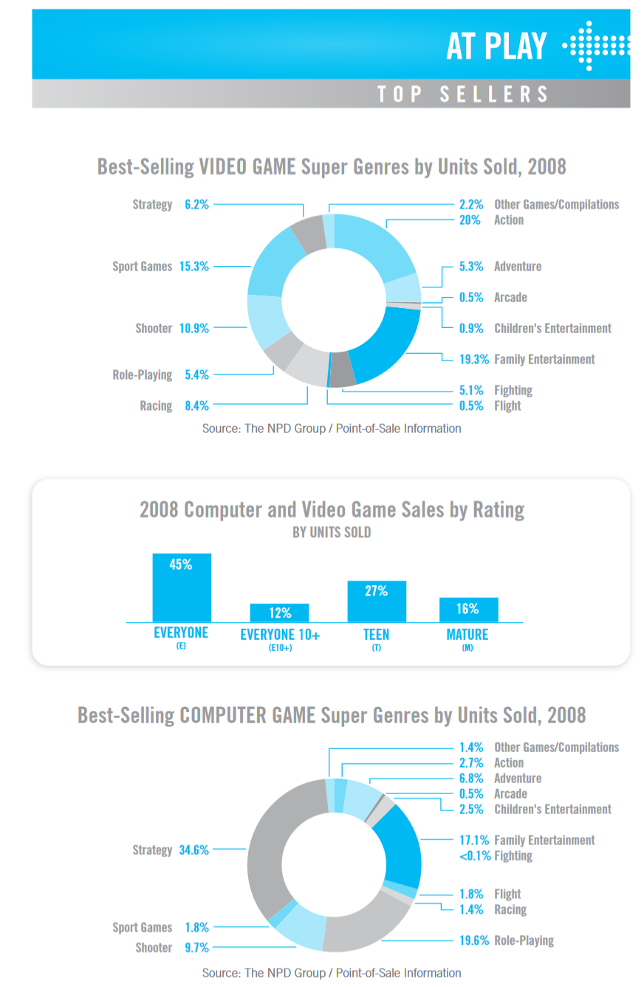
A History of Genres
Genres are a hierarchy.
In the Entertainment Software Association’s 2009 report (here) they identified the Super Genres
We can subdivide the genres further
Sports games can be sub-divided into the type of sport depicted.
Shooter games can be ones that utilise speed (FPS, On-Rails) or those that prefer to emphasise more realistic gameplay and historically accurate weapons with limited ammo.

Slide 7
Design Considerations
As gamers we’re familiar with different game genres, but we’re going to look deeper into the design considerations and mechanics of some popular types, such as:
Puzzle
Platform
Action/ Shoot-em up/ First-Person-Shooters
Strategy
Multiplayer
RPGs

Slide 8
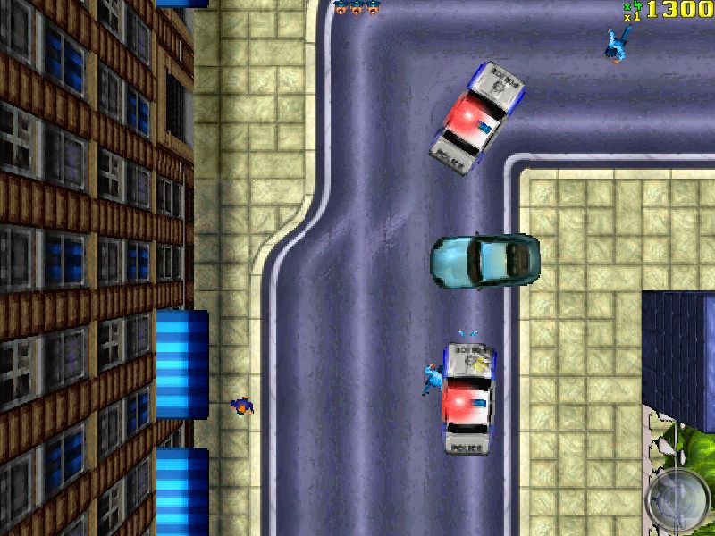
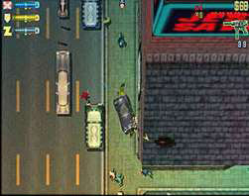
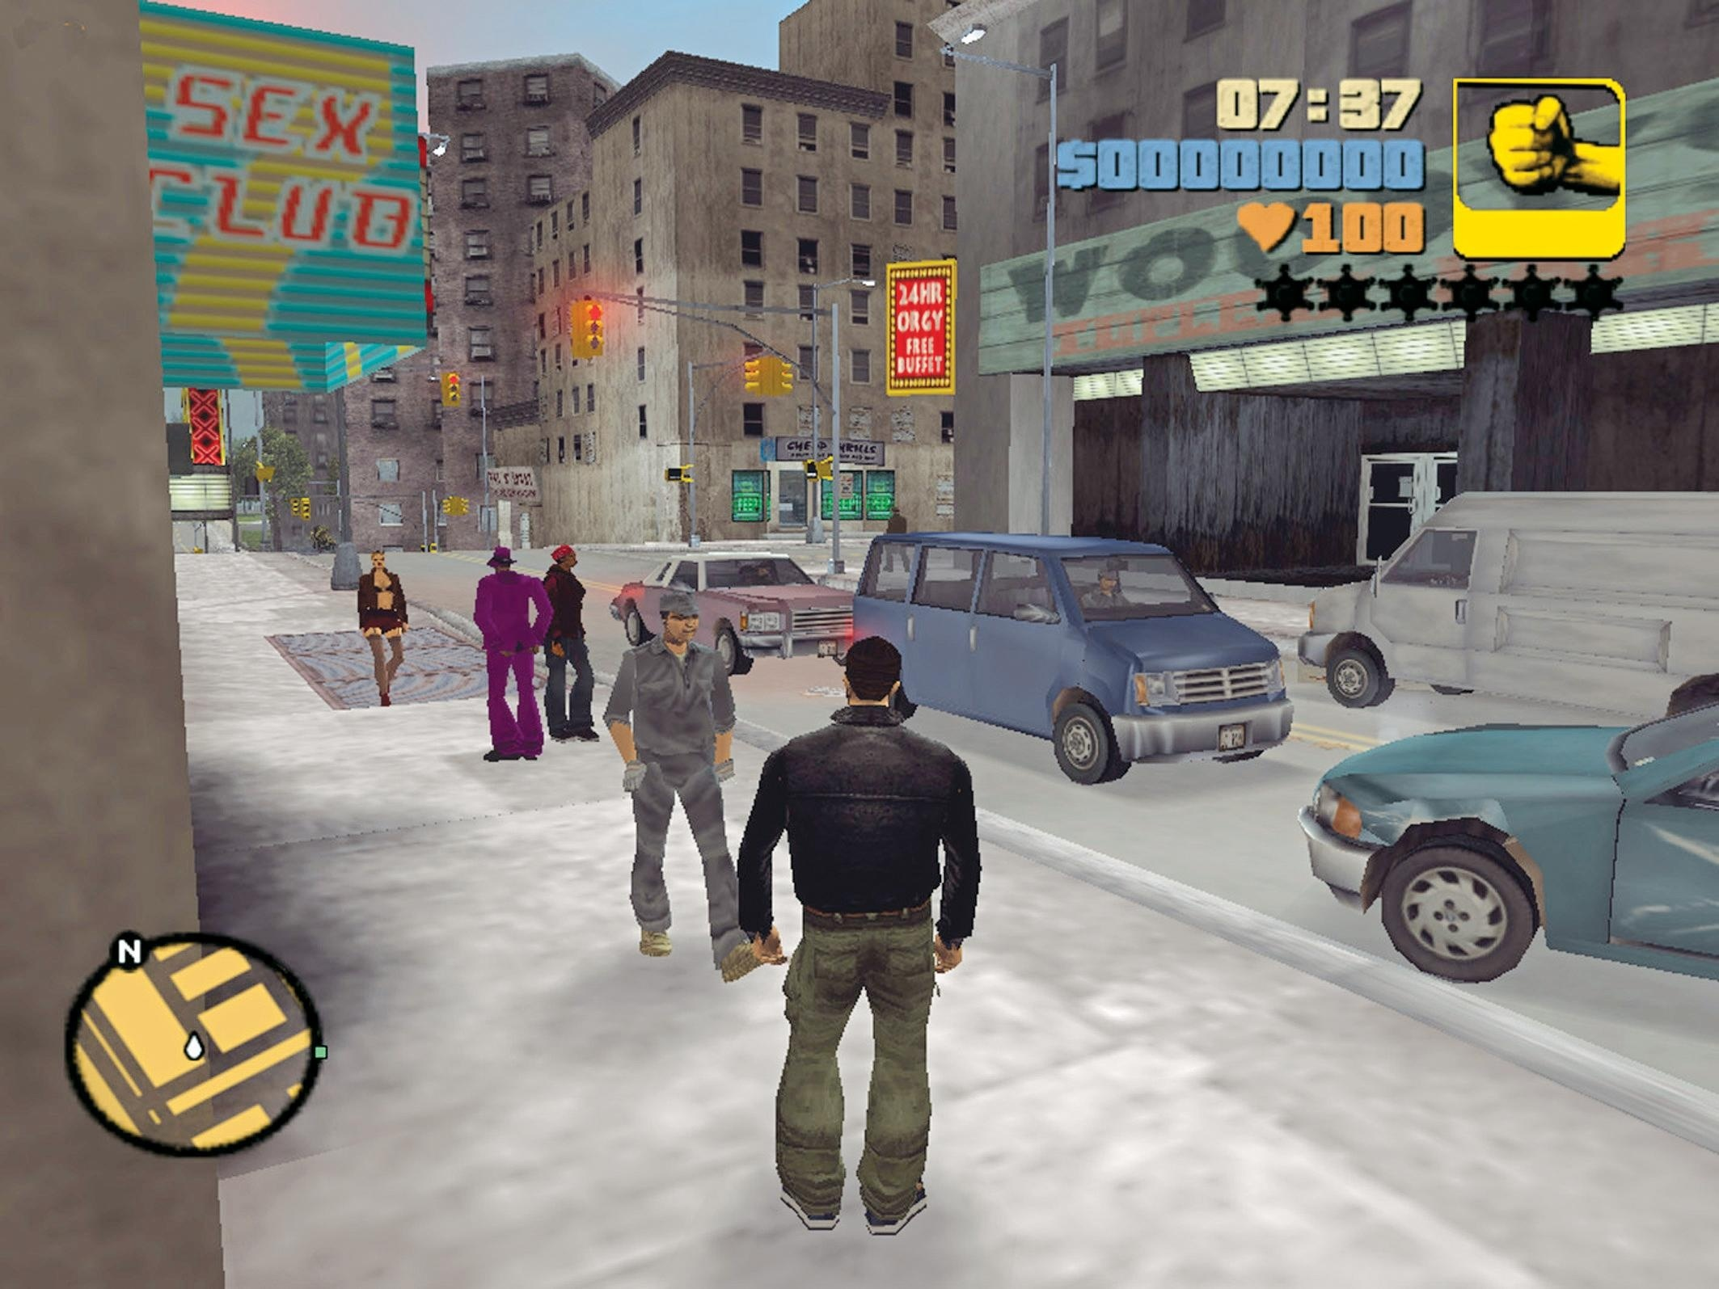
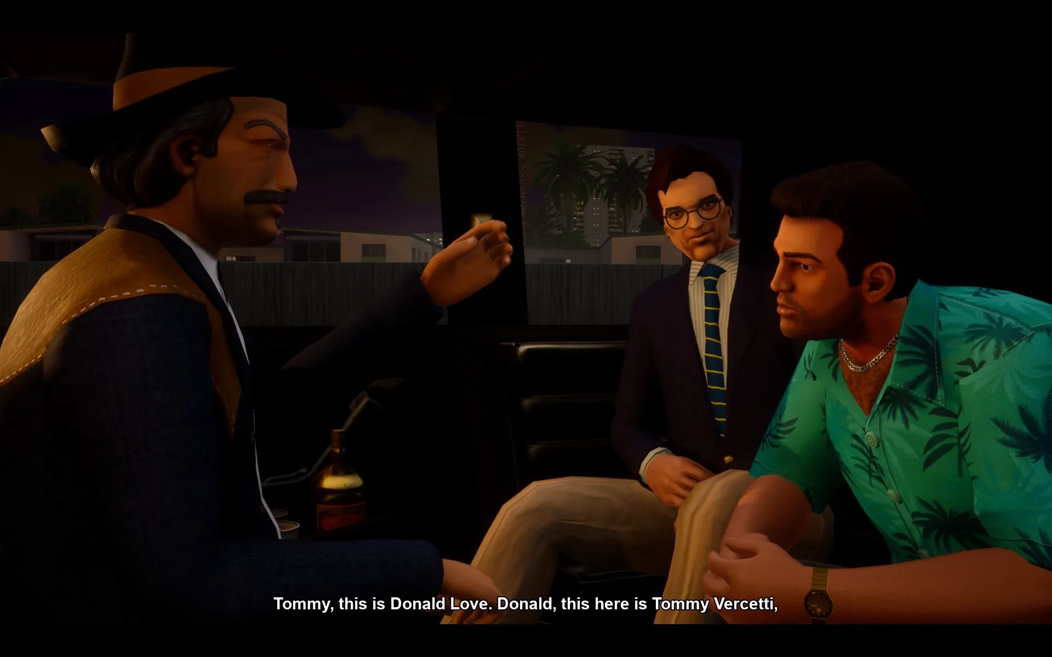
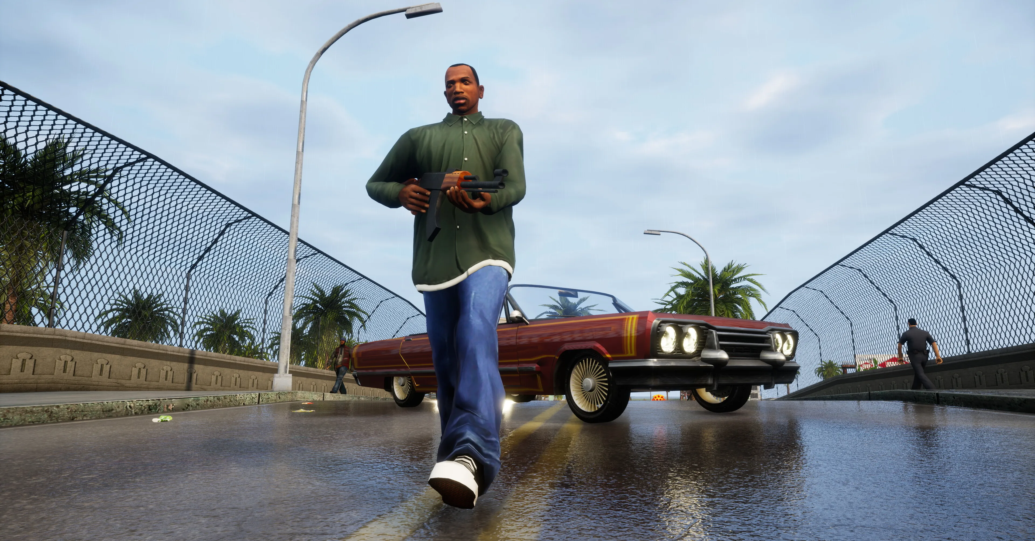
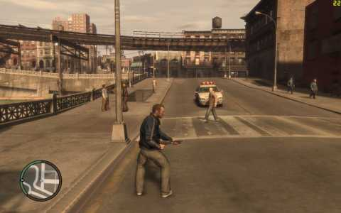
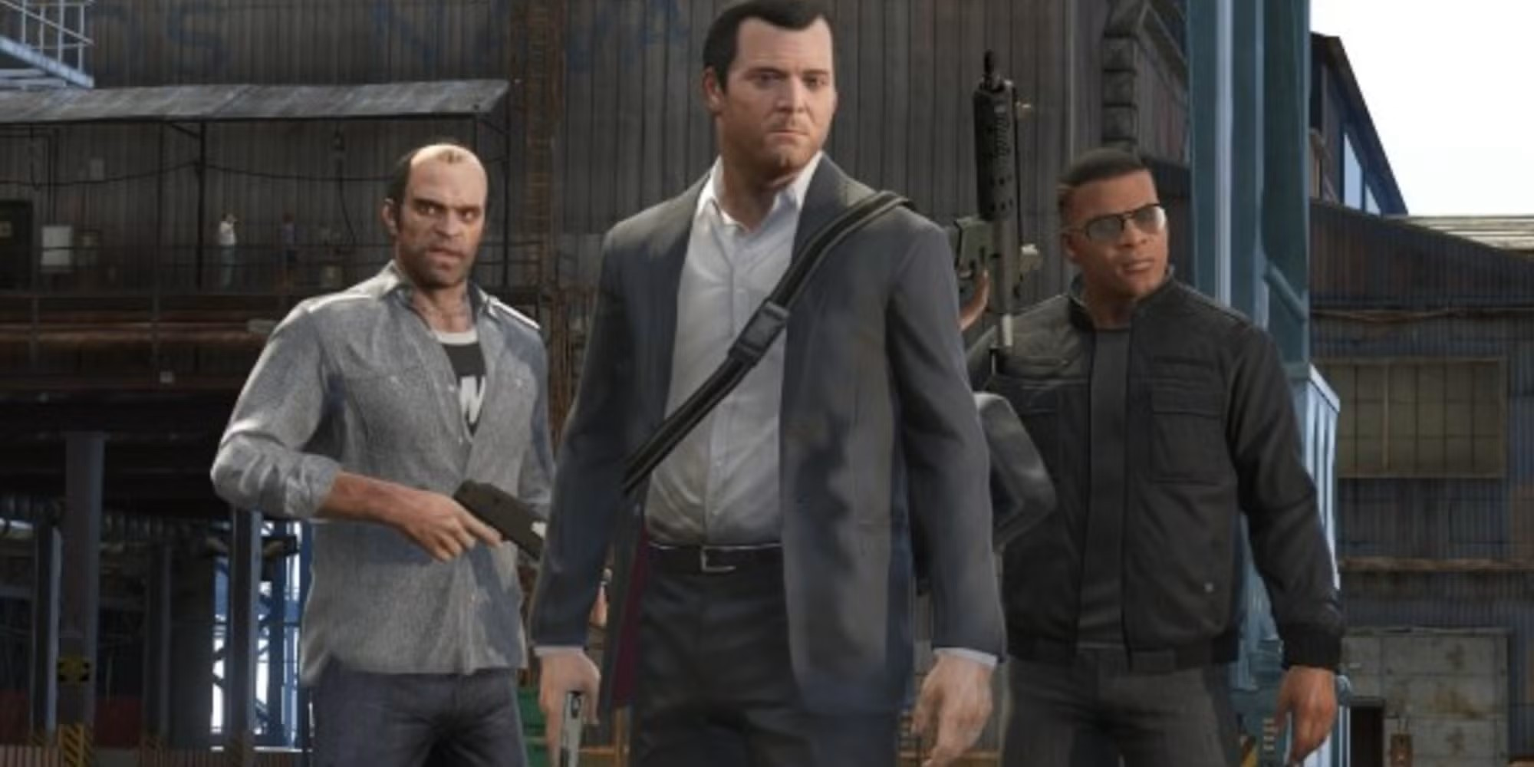
Where have I seen that before?
When genres collide!
According to Crawford (1982), early games were already starting to experiment with mixing genres. He noted that Donkey Kong was ‘vaguely like a race game with intelligent obstacles’ (note: ‘Platformer’ was not a genre included in his taxonomy).
So, what about Grand Theft Auto?
Its genre is Action-Adventure, although the main theme of the game is based around vehicles. The vehicles handle differently depending on their make and model, but it’s not a driving simulator. As the series moved from top-down 2D into 3D with GTA 3, the gameplay began to evolve more into an Action-Adventure with cars.
GTA San Andreas added more RPG-like elements, such as the need to exercise and eat healthy in order to maintain your fitness and stamina.
GTA V/ GTA Online added mini games such as Golf, Tennis, Arcade Machines, and the ability to go to the cinema or watch TV within the game.
GTA: 1, 2, 3, Vice City, San Andreas, 4, and 5 © DMA/ Rockstar North

Slide 9
Anatomy of a Puzzle
Many games contain puzzles or are puzzle-based.
The Puzzle follows a basic structure:
Problem
Outline of the problem and the initial conditions of the puzzle.
Rules
The rules and processes the player goes through to move from the problem to achieve the solution
Solution
The final state where the puzzle is considered complete or solved.
In addition, puzzles also have:
Props
Things you interact with (switches, floor pads, numbers in Sudoku)
Background and UI
Define the theme – if it is a puzzle in a game, what is the lore-friendly reason for it and how is it implemented?

Slide 10
Puzzle Games vs. Puzzles IN Games
Those points (Problem, Rules, Solution) can apply to any game type and provide a useful framework to model anything from a simple puzzle to game-spanning quests.
We do need to differentiate between:
Puzzles as games in their own right
Puzzles in games that form part of a larger whole
If your concepts presents a specific, focused challenge to the player then it’s likely you’re considering a stand-alone puzzle game.
NOTE – The Room series is an interesting example of a stand-alone puzzle game with puzzles within puzzles.

Slide 11
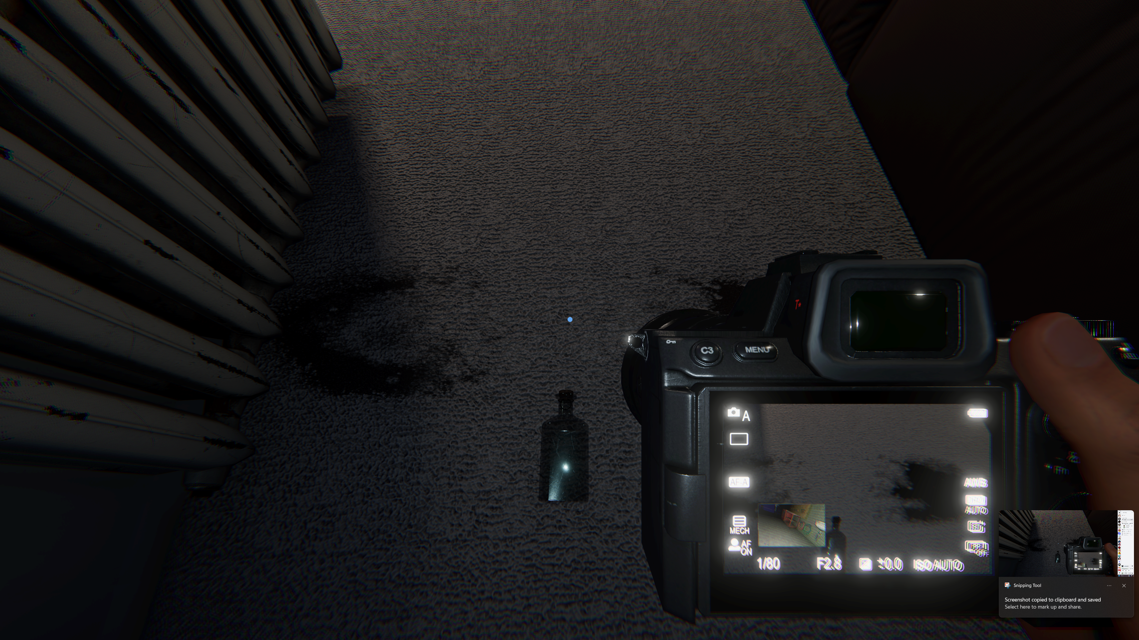
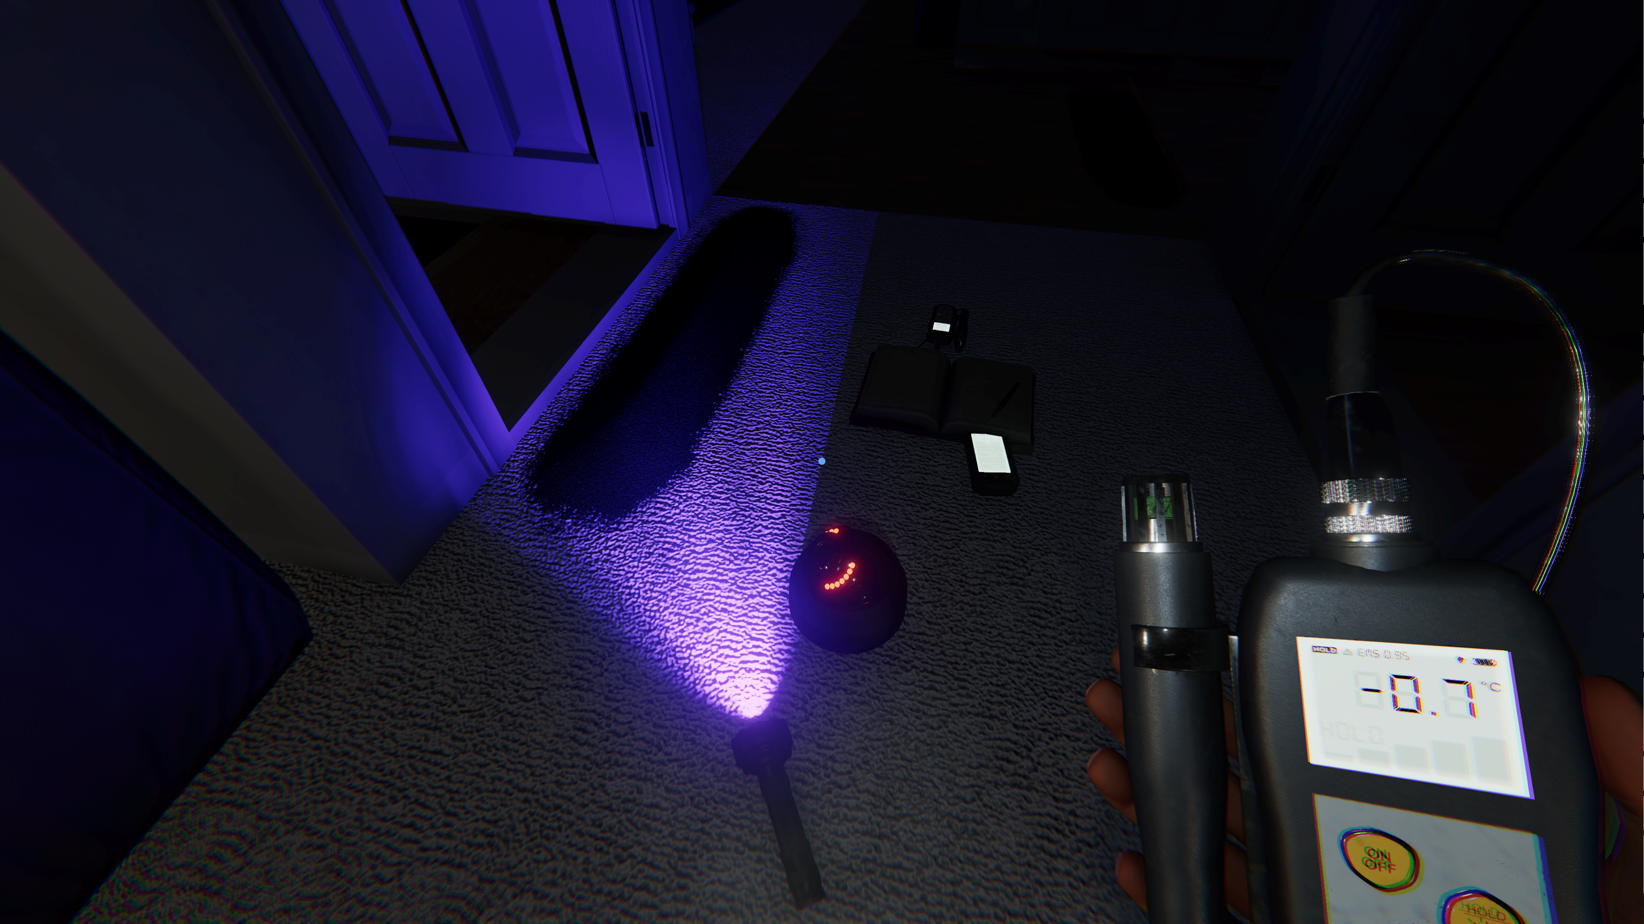
Puzzle Games – Phasmophbia
Made by Kinetic Games in 2020, Phasmophobia started a sub-genre of horror games based around ghost hunting and identification. The whole game is a puzzle, where the investigator(s) utilize a number of tools (temp gun, EMF reader, ultraviolet light) to search for clues in order to correctly identify the ghost, in exchange for cash and experience points. There are a set number of locations in the game and a random chance of getting any one of twenty ghost types, each with their own traits and behaviours, that can lead to a wide variety of scenarios and tactics being employed.

Slide 12
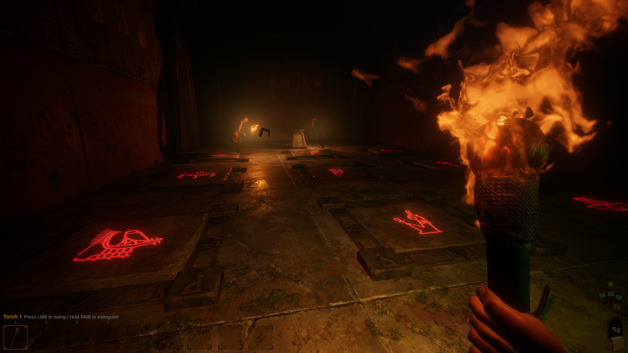
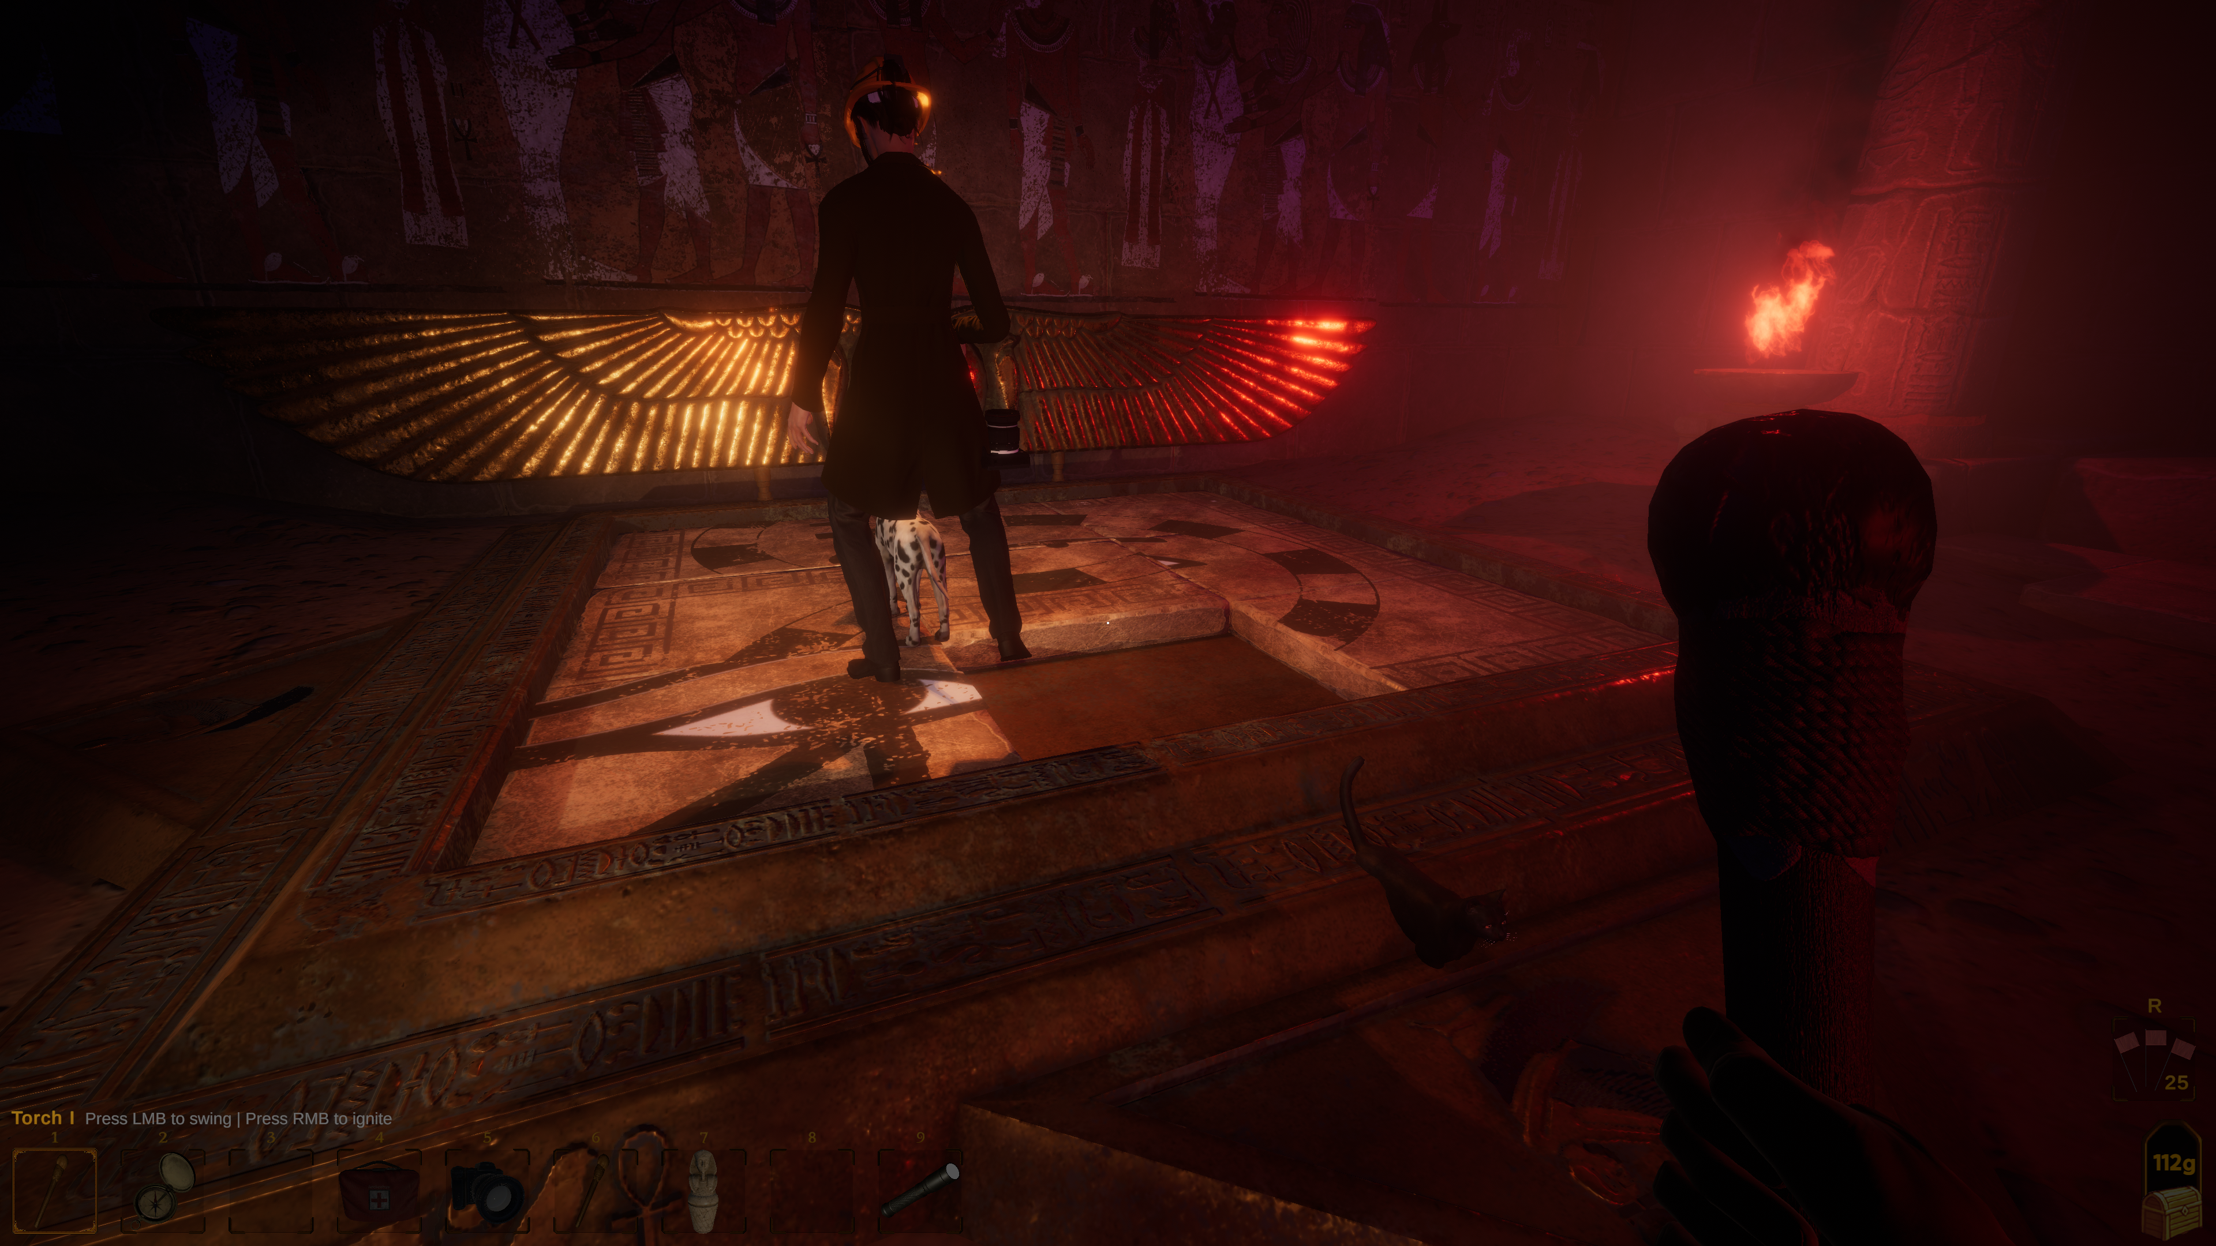
Puzzle Games - Forewarned
Made by Dreambyte Games in 2021, Forewarned is very much in the same genre of horror as Phasmophobia; but rather than exploring suburban locations, you are an archaeologist exploring tombs in Egypt. Using tools provided, you must identify the Mejai (ghost). After you have successfully done this, you then have the option to banish them through a ritual. Forewarned uses more recognisable puzzles within the structure of the gameplay of solving a puzzle.
Puzzle Game meets Puzzle In Games.

Slide 13
Puzzle Games vs. Puzzles in Games
When designing challenges and puzzles that are a part of a larger game, the designer needs to take into account the following considerations:
Puzzles in games should be a temporary hinderance to the player and should be focused, with clear descriptions of the problem and what the outcomes are (the solution). Sub-quests in RPGs should have a clear statement of the problem (the quest) and what is needed to complete it. If your puzzle becomes the focus of attention at the expense of the larger game, then perhaps it should be a stand-alone puzzle game.
Puzzles should fit the theme and world of the larger game. Forewarned uses classic puzzle designs with an ancient Egyptian theme; also drawing on the Indiana Jones-esque idea of trap-laden tombs. The puzzles should exist for a reason – A puzzle to unlock a door to escape a dungeon makes more sense than randomly completing a jigsaw on the way out.

Slide 14
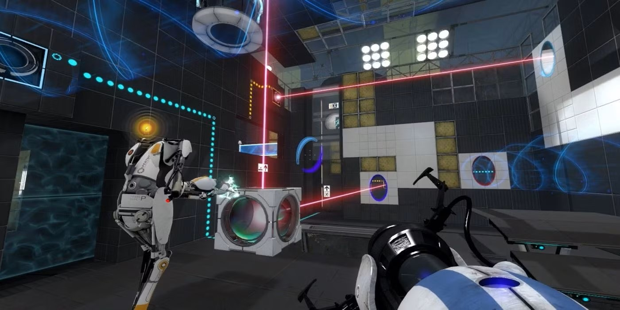
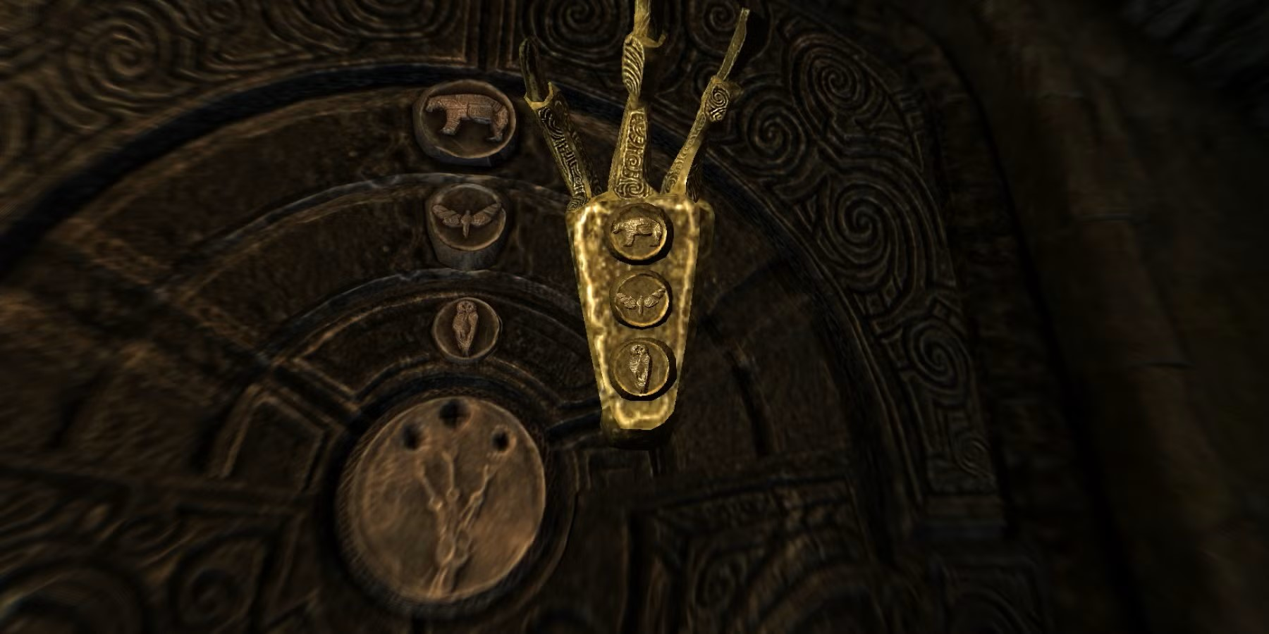
Puzzle Games vs. Puzzles in Games
Puzzles in games should be appropriately challenging. Keep the early puzzles simple while your players are still familiarising themselves with the mechanics and rules of your game world. Portal does this by slowly building up the complexity of the puzzles and increasing the size of the puzzle rooms as players progress.
Props/Objects needed to solve the puzzles should be in suitable locations i.e. where the player won’t miss them! In the Bleakfalls Barrow Quest in Skyrim, the player meets an NPC who has the key (the golden claw) inside the barrow. The game design makes it impossible for the player miss out on the claw needed to open the final door. The claw even has the solution to the door puzzle engraved on it.
Portal © Valve Corporation 2007
Be mindful of cultural and language considerations when you are designing your puzzles.
Elder Scrolls V: Skyrim © Bethesda Softworks 2011

Slide 15
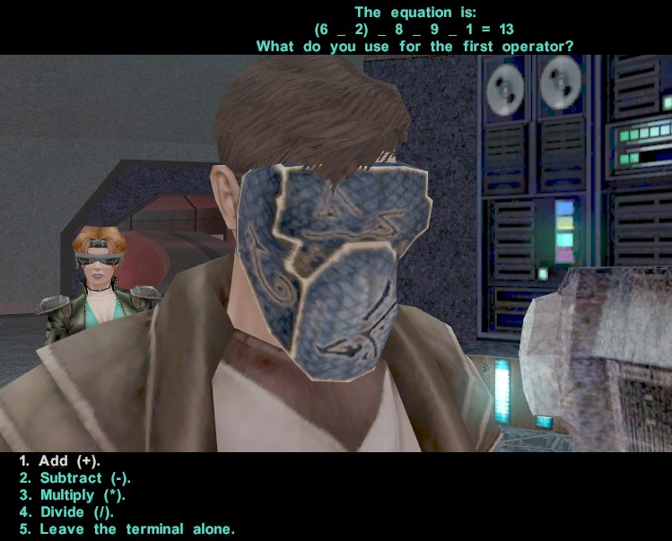
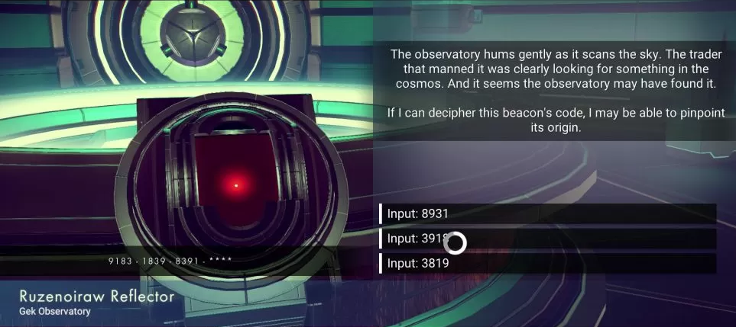
Puzzle Games vs. Puzzles in Games
Puzzle games fall into several different categories, such as:
Word based – Crossword, Word Searches.
Image based – Sliding puzzle, jigsaw.
Logic – Sudoku, maths/ numbers.
Memory – Trivial Pursuit, pattern matching
Dexterity – Tetris, button-combo
Hybrid - Hangman
Knights of the Old Republic 2: The Sith Lords © LucasArts/ Obsidian 2004
No Man’s Sky © Hello Games 2016

Slide 16
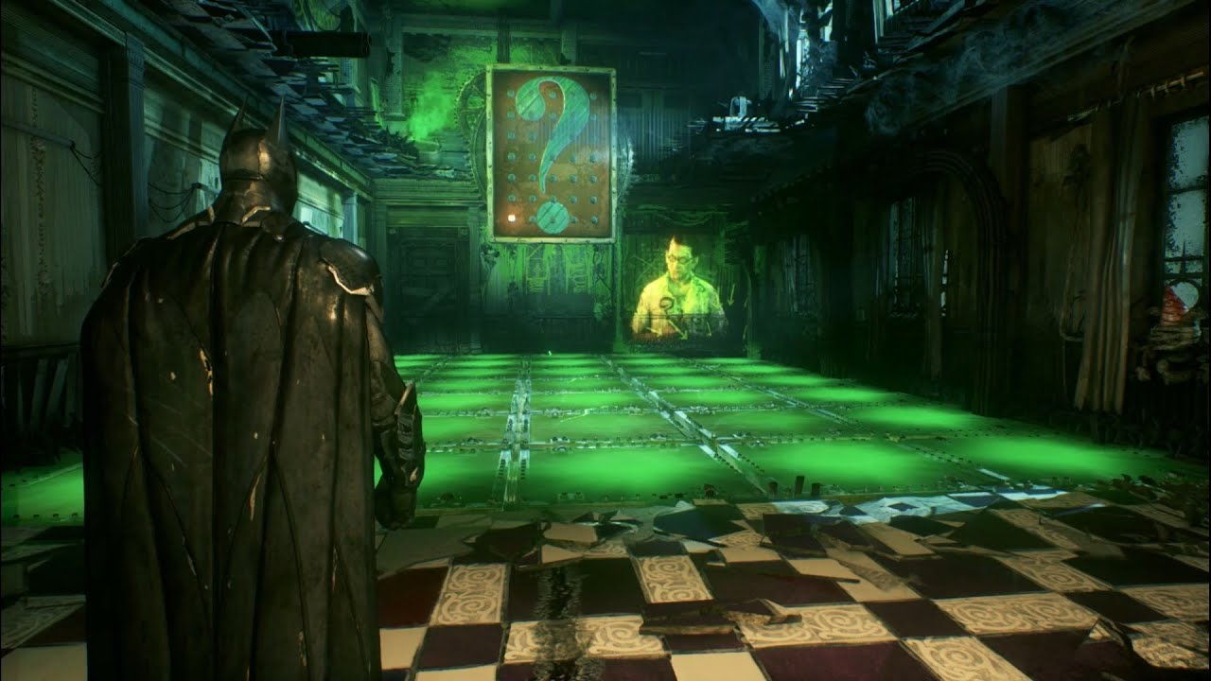
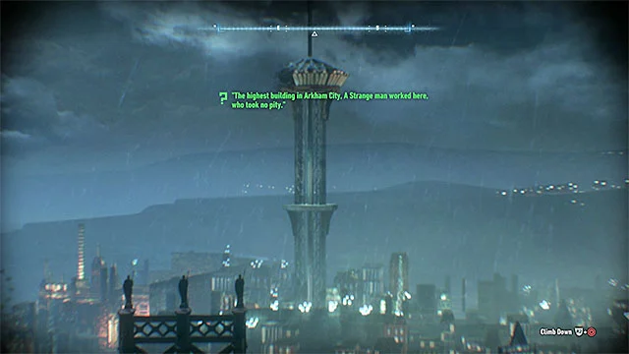
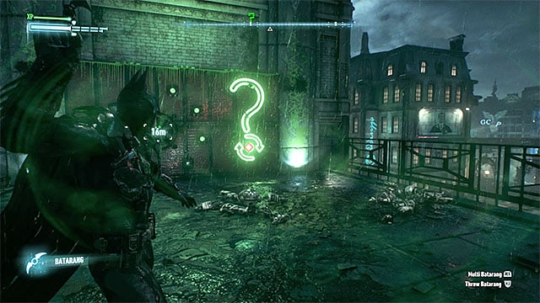
Puzzle Games vs. Puzzles in Games
The Batman Arkham series by Rocksteady Games, through the character of The Riddler, feature many variations on these puzzle types. There are riddles that take the player to different parts of the map, brainteasers, logic puzzles, puzzles based around skill and dexterity.
Once there is an understanding of how a puzzle works, it’s possible to put a unique spin on it.
Batman: Arkham Knight © Rocksteady Studios 2015

Slide 17



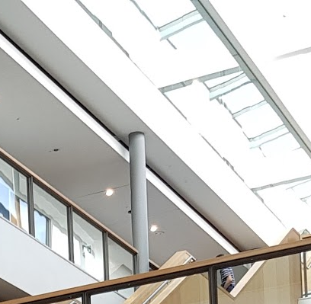



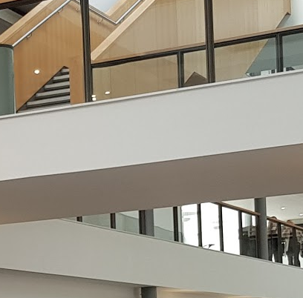
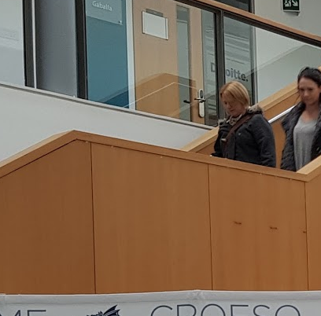






Examples
Sliding Puzzle – Image-based
Problem:
An image is split into an (nxn) grid of squares with the positions randomised and a square removed.
Rules:
1) The player can select any tile that is ‘4 connected’ to the empty tile.
2) The player slides the selected tile along with any immediate tiles to the empty space. The location of the chosen tile is now the new empty slot.
Solution:
The image tiles are arranged so that each portion of the tile is placed correctly within the image as a whole.

Slide 18
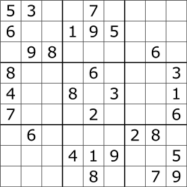
Examples
Sudoku – Logic-based game.
Problem:
A 9x9 array of squares (also a 3x3 array of 3x3 square blocks) is provided. Some squares are populated with numbers, where the rest are blank. The numbers are not random but set so the player can reach the solution.
Rules:
1) The player chooses a blank square to fill in with a number between 1 and 9.
2) The player cannot choose a square with a “given number”. These must remain immutable.
3) Step 1 is repeated until all squares are filled.
Solution:
All nine 3x3 blocks contain 9 unique, non-repeating numbers within the range [1, 9].
All nine 9x1 rows contain 9 unique, non-repeating numbers in the range [1, 9].
All nine 1x9 columns contain 9 unique, non-repeating numbers in the range [1, 9].

Slide 19
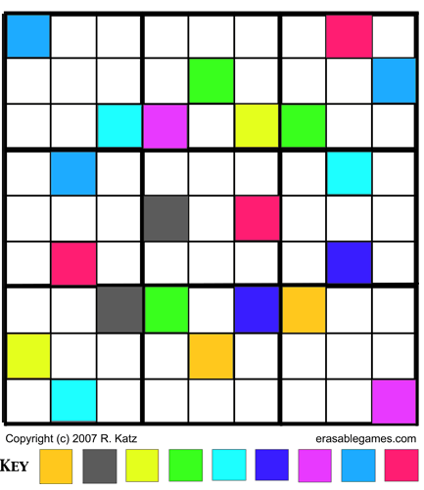
Props
We looked at the anatomy of a puzzle earlier and mentioned props.
The elements manipulated in a puzzle game are props – the visual elements with that player interacts with.
The props can be related to the theme of the game, which is important when integrating the puzzle into a larger game (the sliding tile puzzle in Forewarned).
This introduces a level of abstraction – we can swap out the props whilst retaining the underlying puzzle (problem, rules, solution). For example, Sudoku can be reworked to use 9 unique colours rather than numbers.

Slide 20
Randomisation and Difficulty Scaling
Randomisation can be a useful mechanic to introduce some variability and lend to the replay value.
These can be accomplished by randomising:
The starting conditions of the game, so every play is different.
Elements. New things can be randomly inserted to vary the play and playstyle.
Consideration would need to be given as to how this is done. Too much randomisation may unbalance the flow of the game. Make sure you know what needs to be kept constant/ consistent to keep the game playable.
Example – Tetris has a random starting prop, but there are only a few different shapes available. Regardless of which piece comes first, it will be playable with any that follow.
Sudoku scales its difficulty by removing “given numbers” from the board and leaving more blanks for the player. Crosswords rely on the difficulty of the clues provided, such as cryptic crosswords.

Slide 21
References / Resources
Adams, E. (2009) The Designer’s Notebook: Sorting out the Genre Muddle. Available at: https://web.archive.org/web/20141217155232/http://www.gamasutra.com/view/feature/4074/the_designers_notebook_sorting_.php [Accessed 2 November 2024]
Alt, E. (2023) A Brief History of the Platformer. Activision Blizzard. Available at: https://newsroom.activisionblizzard.com/p/a-brief-history-of-the-platformer [Accessed 2 November 2024]
Crawford, C. (1982) The Art of Computer Game Design. Chapter 3, p.23. Available at: https://www.digitpress.com/library/books/book_art_of_computer_game_design.pdf. [Accessed 2 November 2024]
• Moore, M. “Basics of Game Design” Chapter 9.
Miyamoto, S. (1981) Donkey Kong [Video Game] Nintendo.
Retrogame Deconstruction Zone (2020) What Was the First Platformer, Space Panic or Donkey Kong? [Online] Available at: https://www.retrogamedeconstructionzone.com/2020/07/what-was-first-platformer-space-panic.html [Accessed 2 November 2024]
Universal (1980) Space Panic [Video Game] Universal.

